Slide 1
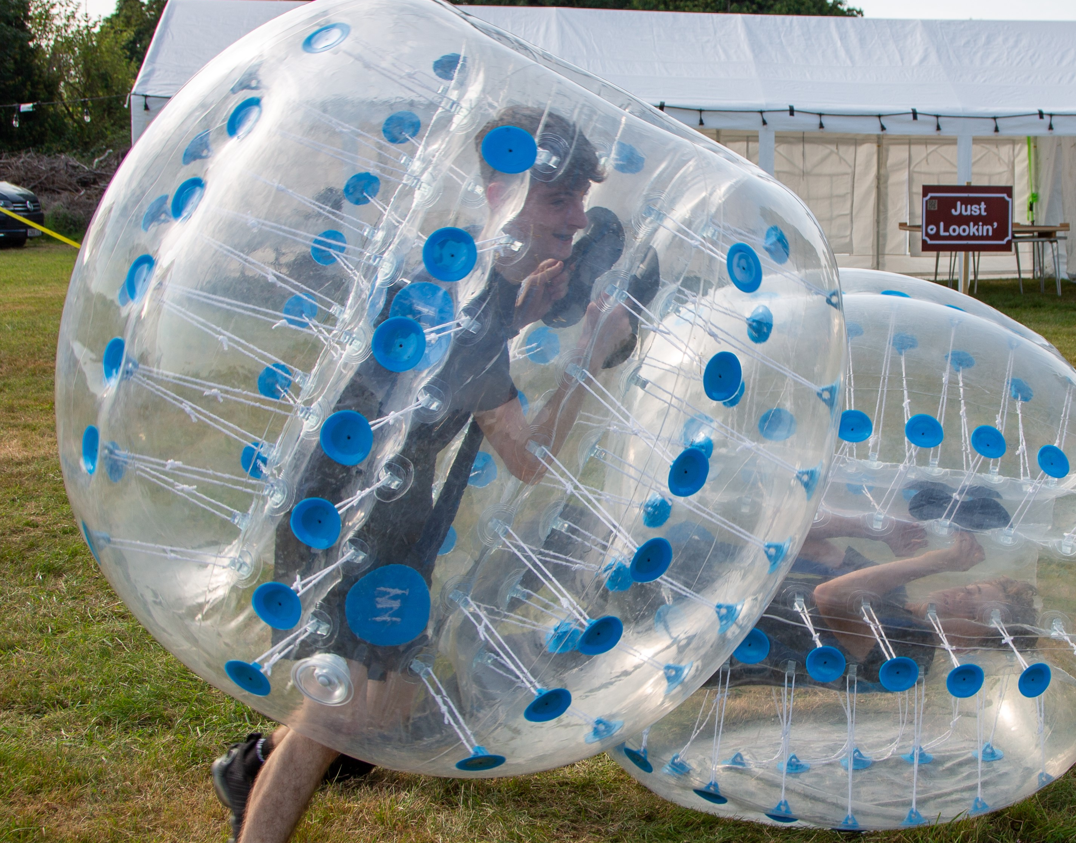
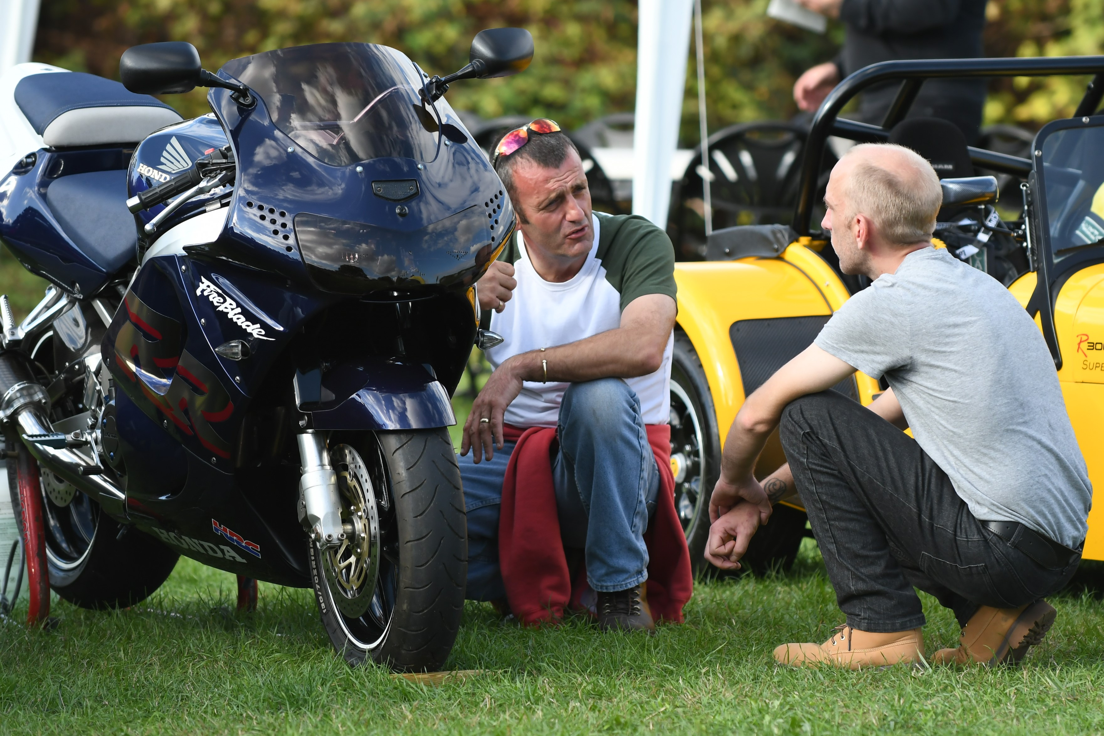
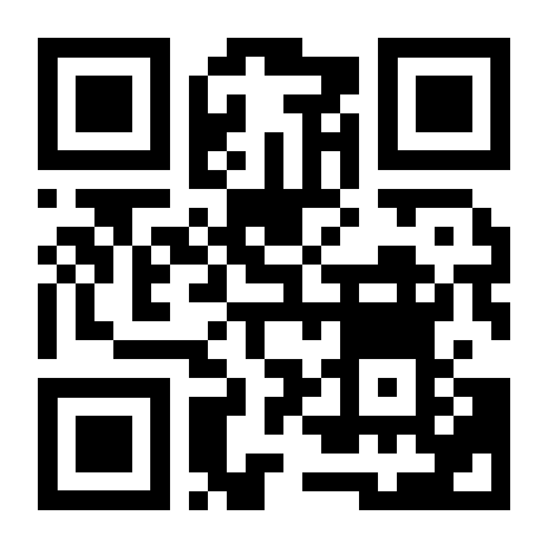
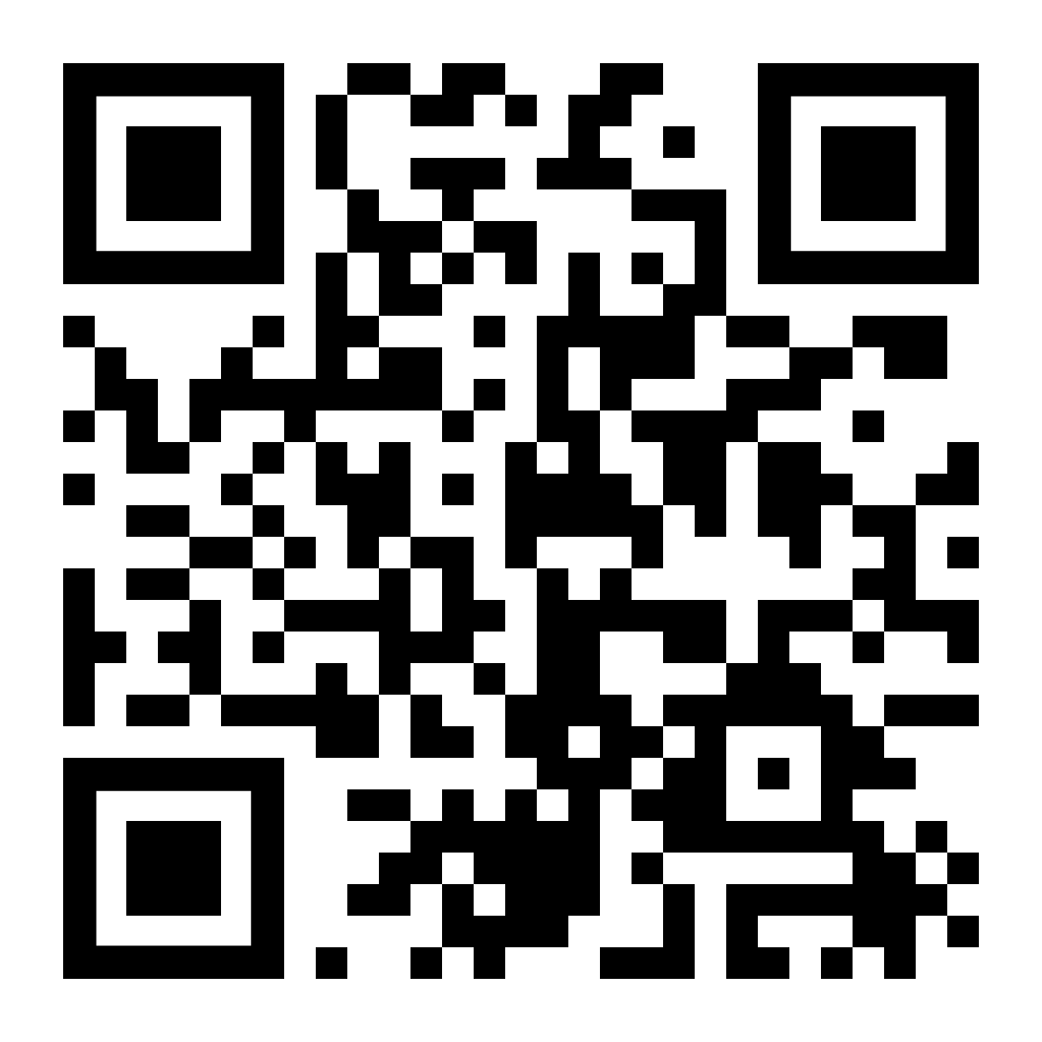
The Forge 2024
A 24 HOUR GATHERING FOR MEN
14TH SEPTEMBER & 15TH SEPTEMBER
1PM TO 1PM
NEW LODGE FARM
CARLSHALTON
SURREY
SM5 4BY
TICKETS £35
(EARLY BIRD £30)
includes:
Saturday BBQ
Camping overnight
Sunday breakfast
CONTACT US
FOR MORE INFO
SCAN TO SIGN UP
info@the-forge.uk
0203 051 8280
the-forge.uk

