Slide 1
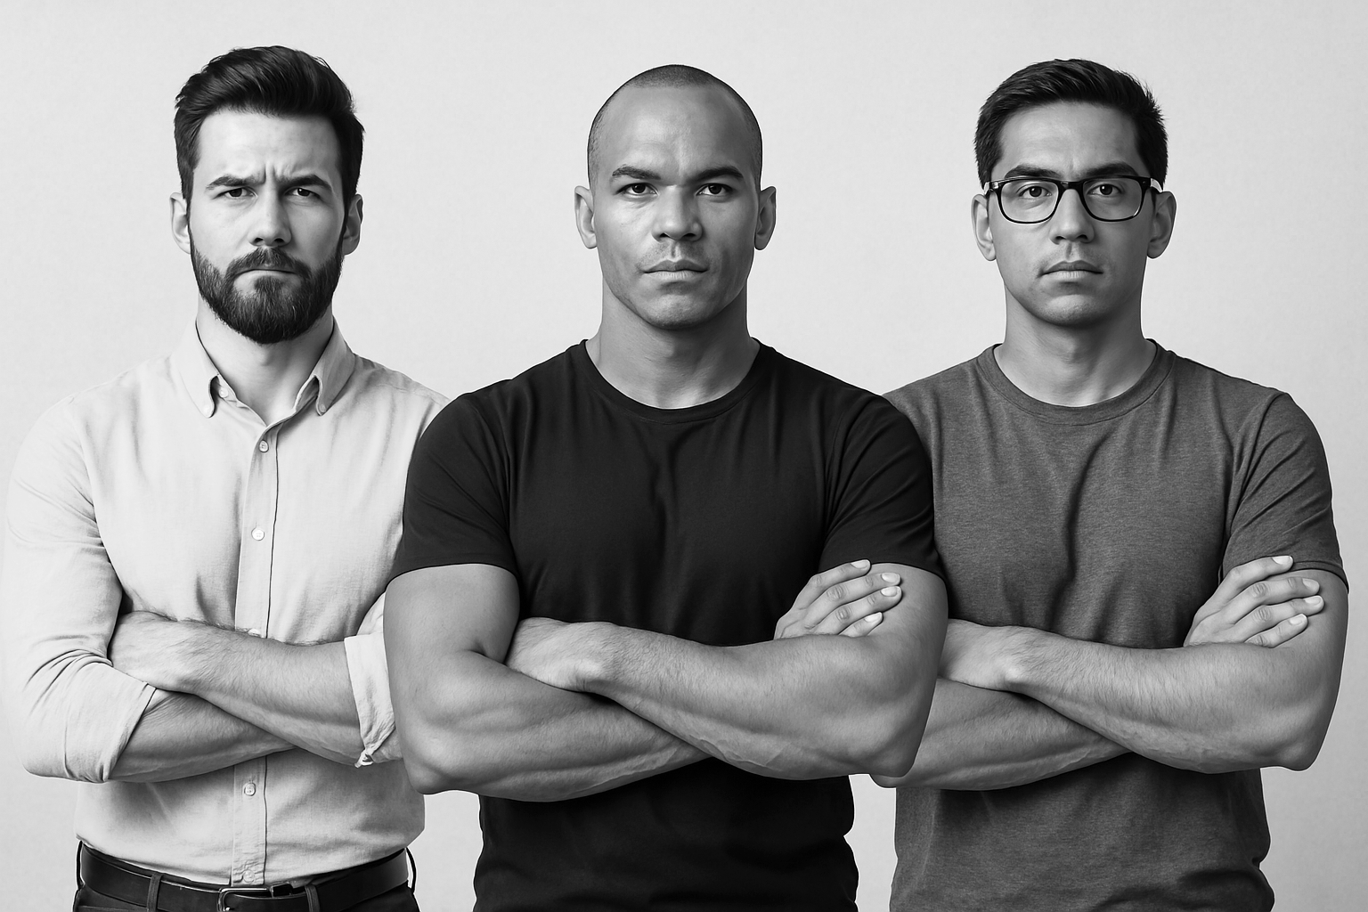
A 24 hour event for men & boys 13+
SAT 6 & SUN 7 SEPTEMBER 25
NEW LODGE FARM, CARSHALTON, SM5 4BY
SPORTS – 5 A SIDE – MINI GOLF
LIFE STORIES – CARS & BIKES
BBQ – COMEDY – LASER TAG
CLIMBING WALL – INFLATABLES
CAMPING – MUSIC - ENTERTAINMENT & MORE
£35
EARLY
BOOKING
DISCOUNTS
ONLINE

